Slide 1

Content: aka.ms/mkedevdays
#Azuredevdays

Slide 2
Azure DevOps Services
Dave Burnison
Technology Solutions Professional - Azure App Dev
Dave.Burnison@Microsoft.com
@DaveBurnison
http://aka.ms/DavesEventList

Slide 3


Slide 4

What is DevOps?
“DevOps is development and operations collaboration”
“DevOps is treating your infrastructure as code”
It’s DevOps!
It’s DevOps!
“DevOps is using automation”
It’s DevOps!
“DevOps is feature switches”
It’s DevOps!
“DevOps is small deployments”
“Kanban for Ops?”
Notes:
Ask the audience questions
Are your builds and deployments totally automated?
Do you have traceability from Requirements > Code > Build > Test > Deployments
What tools do you use today? GitHub?

Slide 5
What is DevOps?
People. Process. Products.
Build& Test
Deploy
DevOps is the union of people, process, and products to enable continuous delivery of value to your end users.
“
Continuous Delivery
Develop
Operate
”
Plan & Track
Monitor & Learn

Slide 6
What technologies do I need to support DevOps?
DevOps brings together people, processes, and products, automating software delivery to provide continuous value to your users. Using Azure DevOps, you can deliver software faster and more reliably - no matter how big your IT department or what tools you’re using.
Continuous integration (CI)
Improve software development quality and speed.
When you use Azure Pipeliens or Jenkins to build apps in the cloud and deploy to Azure, each time you commit code, it’s automatically built and tested and bugs are detected faster.
Continuous Deployment (CD)
By combining continuous integration and infrastructure as code (IaC), you’ll achieve identical deployments and the confidence to deploy to production at any time.
With continuous deployment, you can automate the entire process from code commit to production if your CI/CD tests are successful.
Continuous Learning & Monitoring
With Azure Application Insights you can identify how your applications are performing and test if the recent deployment made things better or worse.
Using CI/CD practices, paired with monitoring tools, you’ll be able to safely deliver features to your customers as soon as they’re ready.
Notes:
Ask the audience questions
Are your builds and deployments totally automated?
Do you have traceability from Requirements > Code > Build > Test > Deployments
What tools do you use today? GitHub?

Slide 7




Business Needs
Accelerate time-to-market while reducing costs
Drive innovation
Reach and engage

Slide 8
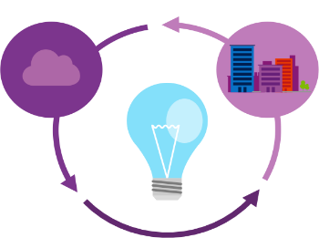
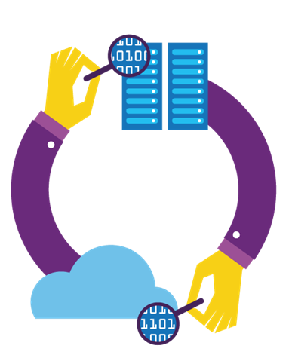
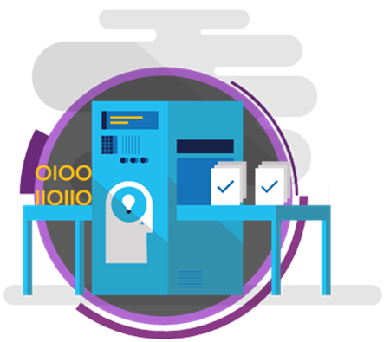
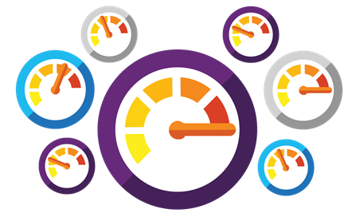
What needs to change to address those needs?
Shorten cycle times and deliver value faster
Improve quality and availability
Optimize resources and eliminate waste
Deliver innovation and great customer experience through experimentation

Slide 9


High Performance DevOps Companies Achieve…
46x Deployment
Frequency
2,555x Faster Lead
Time For Changes
Faster
Time to Market
DevOps
$
Increased
Revenue
7x Lower Change
Failure Rate
2,604x Faster Mean
Time to Recover
Source: 2018 Accelerate: State of DevOps: Strategies for a New Economy." N. Forsgren, J. Humble, G. Kim. DevOps Research and Assessment (DORA)
Notes:
Our analysis shows that high performers do significantly less manual work across all vectors, spend more time doing new work, and spend less time remediating security issues or defects than their low-performing counterparts. Because they build quality in, they spend less time fixing problems downstream, freeing up more time to do value-add work.
(Page 27).
High performers are twice as likely to exceed organizational performance goals as low performers: profitability, productivity, market share, number of customers.
(Page 24).
We’ve found that these benefits and results apply equally to all organizations, regardless of their industry vertical.
(Page 3).
Our analysis shows that any team in any industry, whether subject to a high degree of regulatory compliance or not—across all industry verticals—has the ability to achieve a high degree of software delivery performance.
(Page 11).

Slide 10

Does doing well on these metrics Matter?
Survey respondents were asked to rate their organizations’ relative performance across several dimensions
Profitability
Market share
Productivity
“high performing organizations …twice as likely to exceed these goals as low performers”
“…also twice as likely to exceed objectives in …achieving organization or mission goals”
…high performers had 50% higher market capitalization growth over 3 years compared to low performers”
➔
https://itrevolution.com/book/accelerate/
Notes:
https://itrevolution.com/book/accelerate/

Slide 11
How Microsoft can help
Microsoft Azure is a powerful and flexible foundation for past, present, and future apps – easily build, manage, and deploy any application and any stack on a massive, global network using your favorite tools and frameworks.
Flexible
Powerful
Open
Choice of IaaS, PaaS, public cloud or hybrid.
Mirror or modernize app infrastructure with VMs, containers, microservices or serverless.
Supports all stages of the app modernization journey – from lift-and-shift to Cloud-Native.
Instantly improve the performance, scalability and resiliency of your apps by moving them to the cloud.
Increase business agility with Cloud-Native capabilities and built-in DevOps for continuous innovation.
Bring your stack, we bring a cloud that runs any app, on any platform, and any language.
Build applications using the language and tools of your choice - Azure supports what you already use and love so you can get up and running fast – just bring code.

Slide 12





Introducing Azure DevOps
Azure Boards
Azure Pipelines
Azure Repos
Deliver value to your users faster using proven agile tools to plan, track, and discuss work across your teams.
Build, test, and deploy with CI/CD that works with any language, platform, and cloud. Connect to GitHub or any other Git provider and deploy continuously.
Get unlimited, cloud-hosted private Git repos and collaborate to build better code with pull requests and advanced file management.
Azure Test Plans
Azure Artifacts
➔
Test and ship with confidence using manual and exploratory testing tools.
Create, host, and share packages with your team, and add artifacts to your CI/CD pipelines with a single click.
https://azure.com/devops

Slide 13



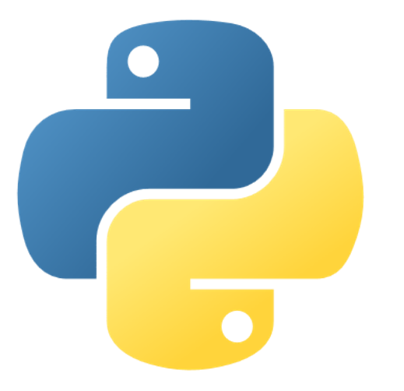
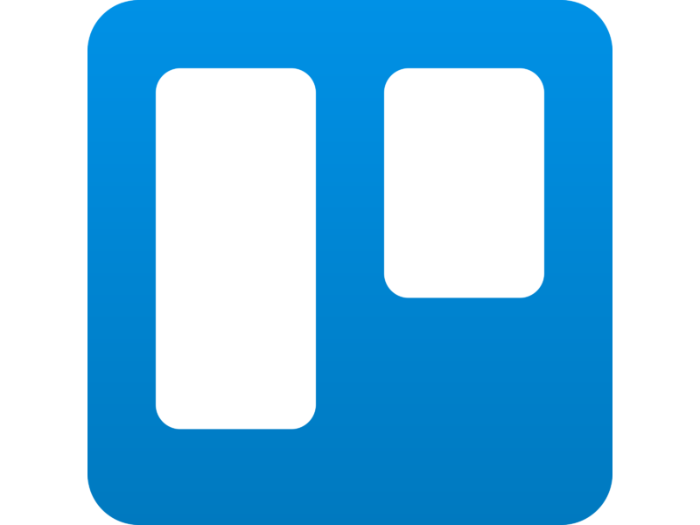


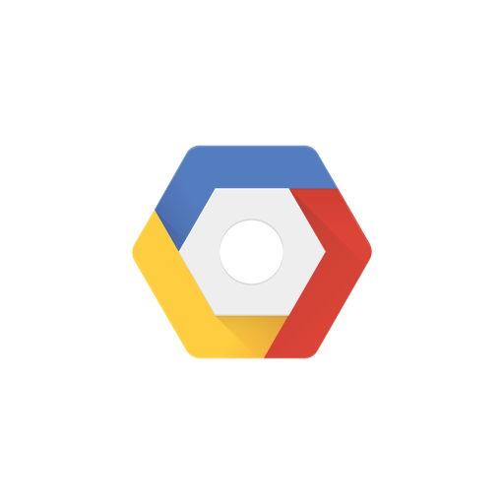

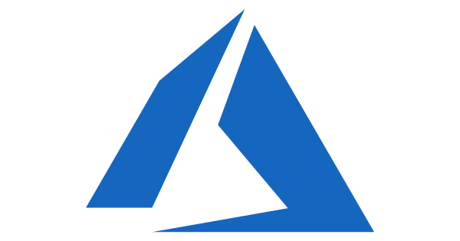


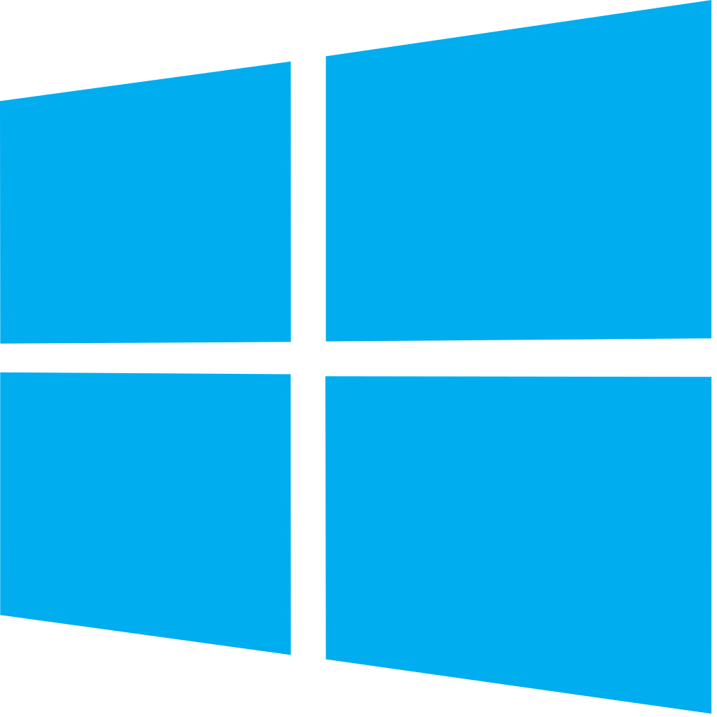


Azure DevOps: Choose what you love
Any Language, Any Platform
Azure DevOps lets developers choose the tools and languages that are right for them
Mix and match to create workflows with tools from Microsoft, open source or your favorite 3rd party tools
Target any cloud, on-prem or both and deploy to the servers you need

Slide 14
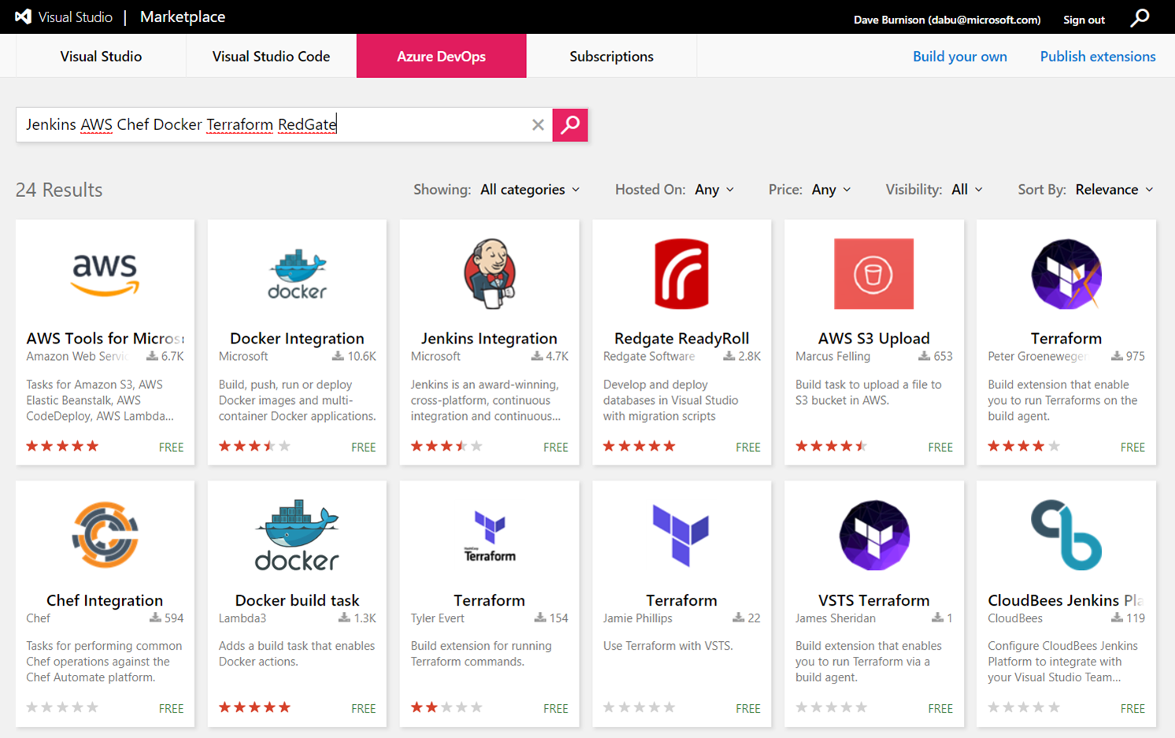
Get 3rd Party Extensions in the Azure DevOps Marketplace
https://marketplace.visualstudio.com/azuredevops
➔

Slide 15











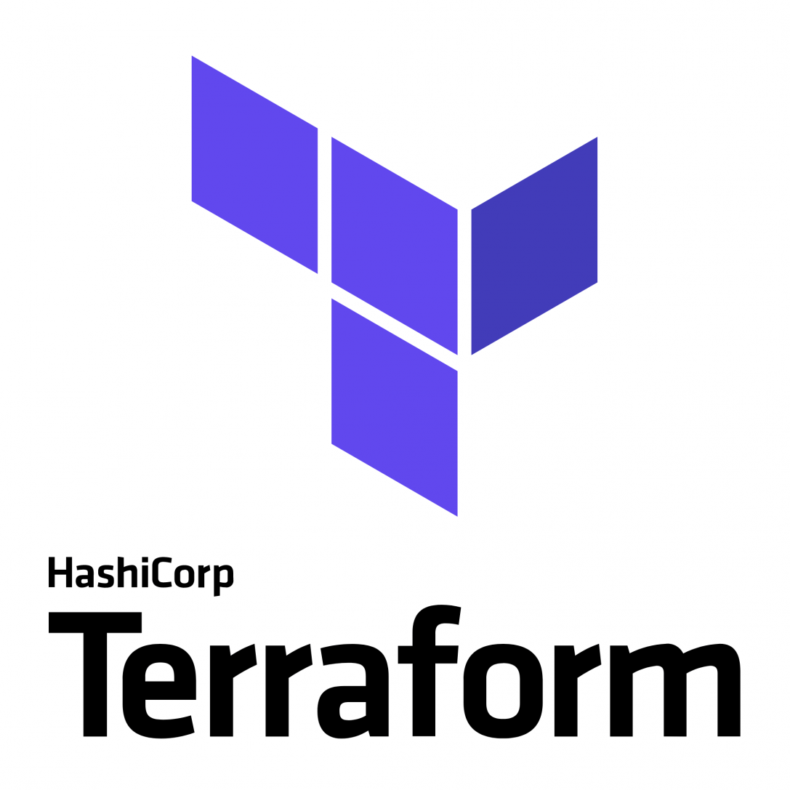

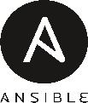



Broadening the Azure Ecosystem
Microsoft
Azure

Slide 16
Azure DevOps Services
Demo
Notes:
Demo : dev.azure.com

Slide 17

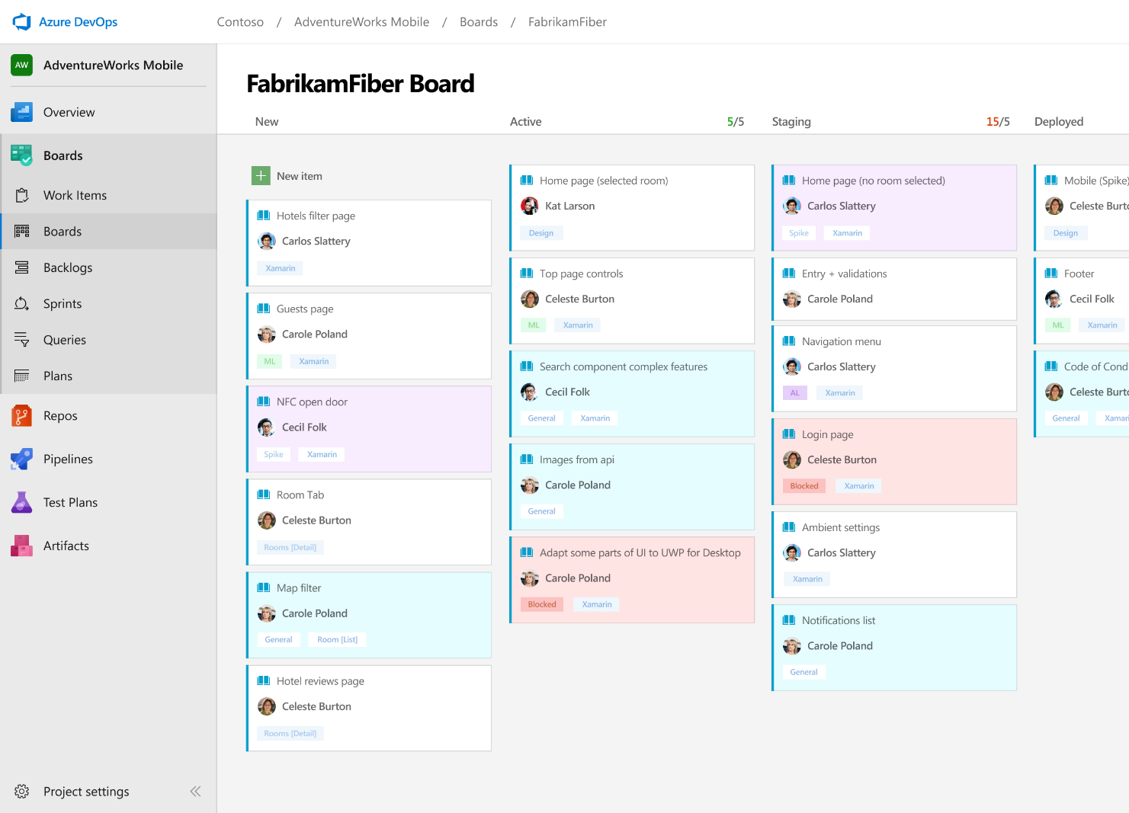



Azure Boards
Track work with Kanban boards, backlogs, team dashboards, and custom reporting
Connected from idea to release
Track all your ideas at every development stage and keep your team aligned with all code changes linked directly to work items.
Scrum ready
Use built-in scrum boards and planning tools to help your teams run sprints, stand-ups, and planning meetings.
Project insights
Gain new insights into the health and status of your project with powerful analytics tools and dashboard widgets.
➔
https://azure.com/devops

Slide 18
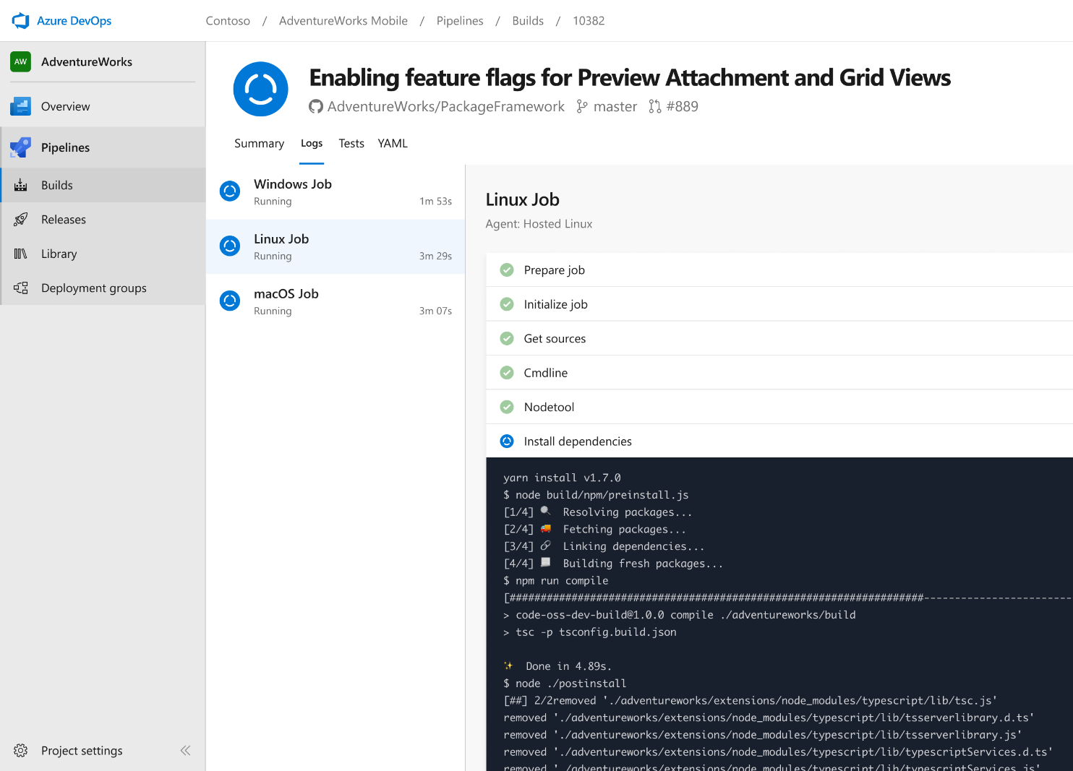


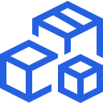
Azure Pipelines
Cloud-hosted pipelines for Linux, Windows and macOS.
Any language, any platform, any cloud
Build, test, and deploy Node.js, Python, Java, PHP, Ruby, C/C++, .NET, Android, and iOS apps. Run in parallel on Linux, macOS, and Windows. Deploy to Azure, AWS, GCP or on-premises
Extensible
Explore and implement a wide range of community-built build, test, and deployment tasks, along with hundreds of extensions from Slack to SonarCloud. Support for YAML, reporting and more
Containers and Kubernetes
Easily build and push images to container registries like Docker Hub and Azure Container Registry. Deploy containers to individual hosts or Kubernetes.
➔
https://azure.com/pipelines

Slide 19

Azure Pipelines
Cloud-hosted pipelines for Linux, Windows and macOS, with unlimited minutes for open source
Any language, any platform, any cloud
Build, test, and deploy Node.js, Python, Java, PHP, Ruby, C/C++, .NET, Android, and iOS apps. Run in parallel on Linux, macOS, and Windows. Deploy to Azure, AWS, GCP or on-premises
Extensible
Explore and implement a wide range of community-built build, test, and deployment tasks, along with hundreds of extensions from Slack to SonarCloud. Support for YAML, reporting and more
Containers and Kubernetes
Easily build and push images to container registries like Docker Hub and Azure Container Registry. Deploy containers to individual hosts or Kubernetes.
Best-in-class for open source
Ensure fast continuous integration/continuous delivery (CI/CD) pipelines for every open source project. Get unlimited build minutes for all open source projects with up to 10 free parallel jobs across Linux, macOS and Windows
➔
https://azure.com/pipelines

Slide 20
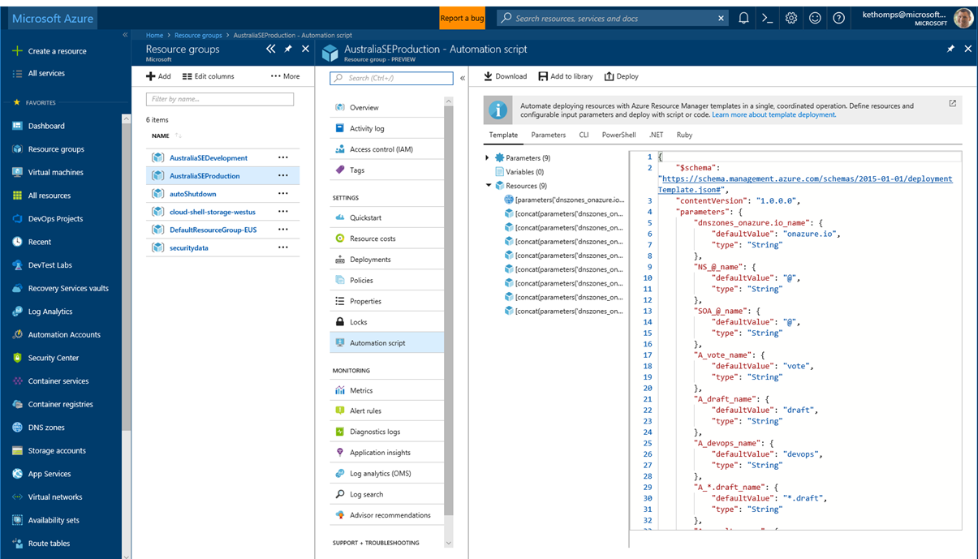
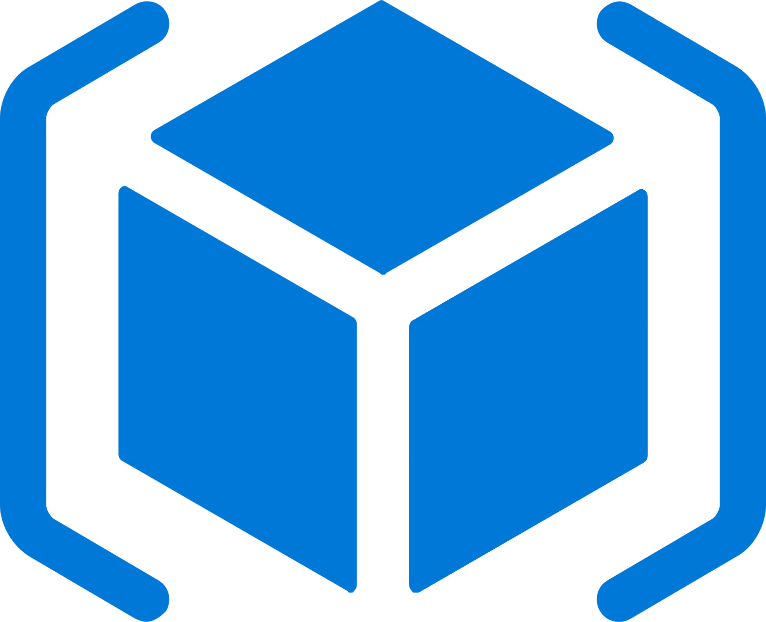


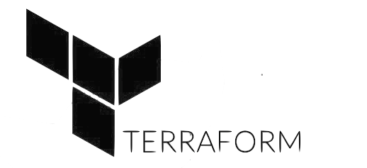
Deploy Repeatedly & Reliably
Azure Resource Manager & DevOps Tool Integrations
Infrastructure as Code, built-in with Azure Resource Manager
Use Azure Automation & Config to automate repetitive tasks
Support for DevOps tool integrations and OSS tooling such as Terraform, Ansible & Chef

Slide 21
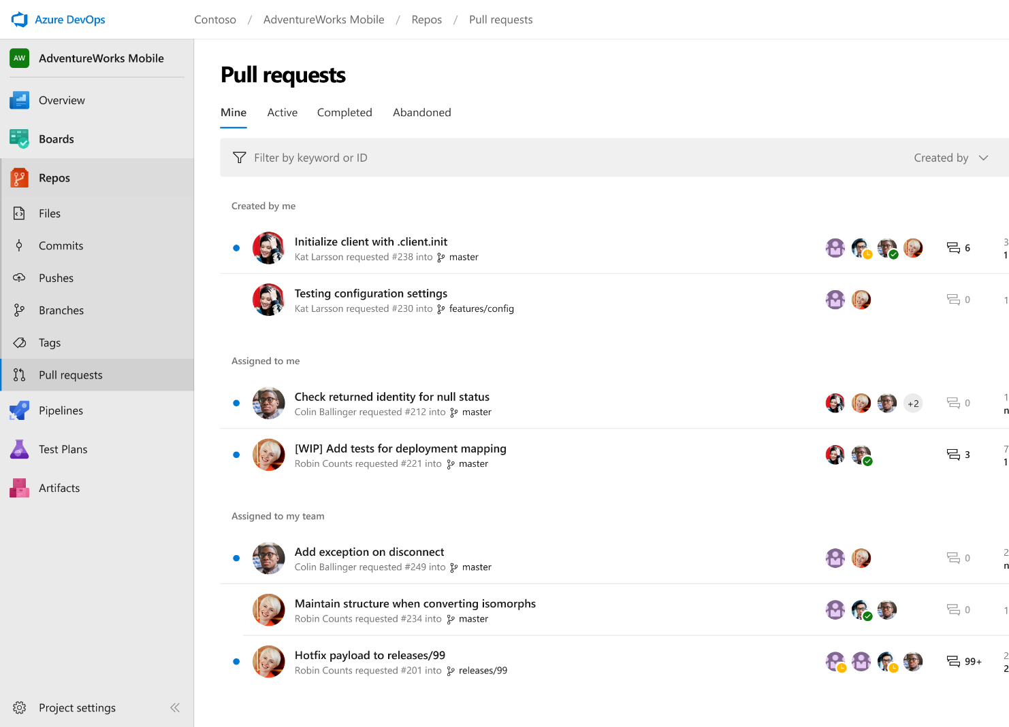



Azure Repos
Unlimited private Git repo hosting and support for TFVC that scales from a hobby project to the world’s largest Git repositories
Works with your Git client
Securely connect with and push code into your Git repos from any IDE, editor, or Git client.
Web hooks and API integration
Add validations and extensions from the marketplace or build your own using web hooks and REST APIs.
Semantic code search
Quickly find what you’re looking for with code-aware search that understands classes and variables.
➔
https://azure.com/devops

Slide 22
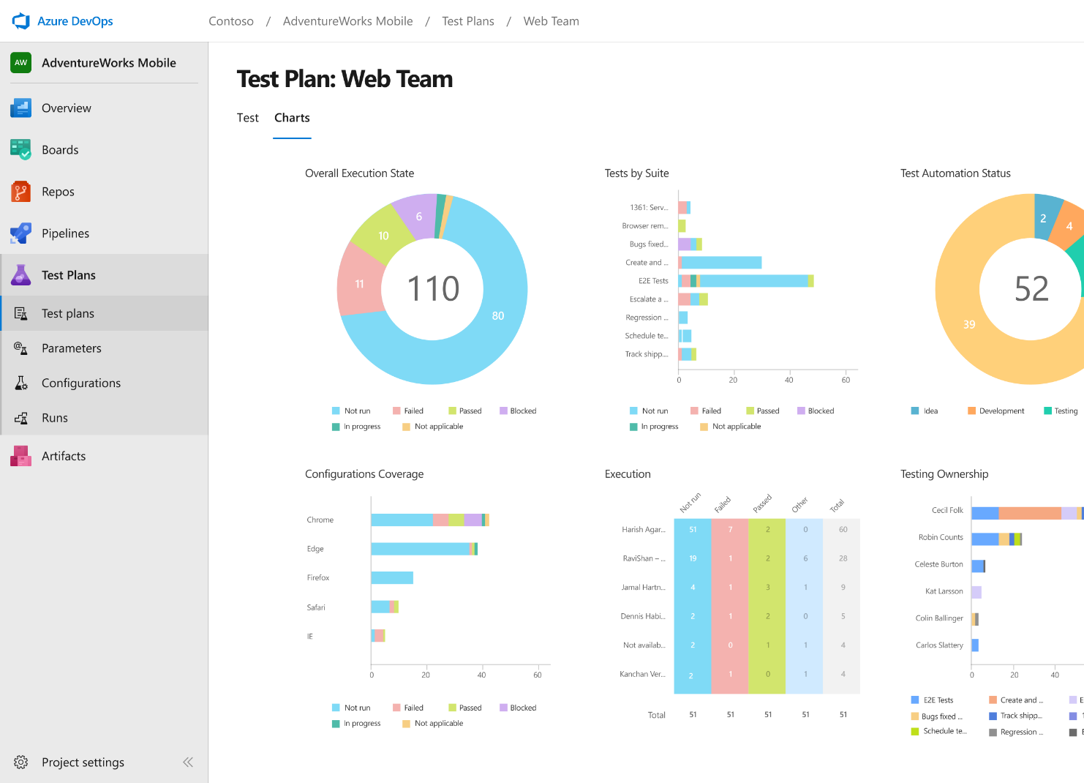
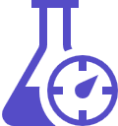


Azure Test Plans
Get end-to-end traceability. Run tests and log defects from your browser. Track and assess quality throughout your testing lifecycle.
Capture rich data
Capture rich scenario data as you execute tests to make discovered defects actionable. Explore user stories without test cases or test steps. You can create test cases directly from your exploratory test sessions.
Test across web and desktop
Test your application where it lives. Complete scripted tests across desktop or web scenarios. Test on-premises application from the cloud and vice-versa.
Get end-to-end traceability
Leverage the same test tools across your engineers and user acceptance testing stakeholders. Pay for the tools only when you need them.
➔
https://azure.com/devops

Slide 23
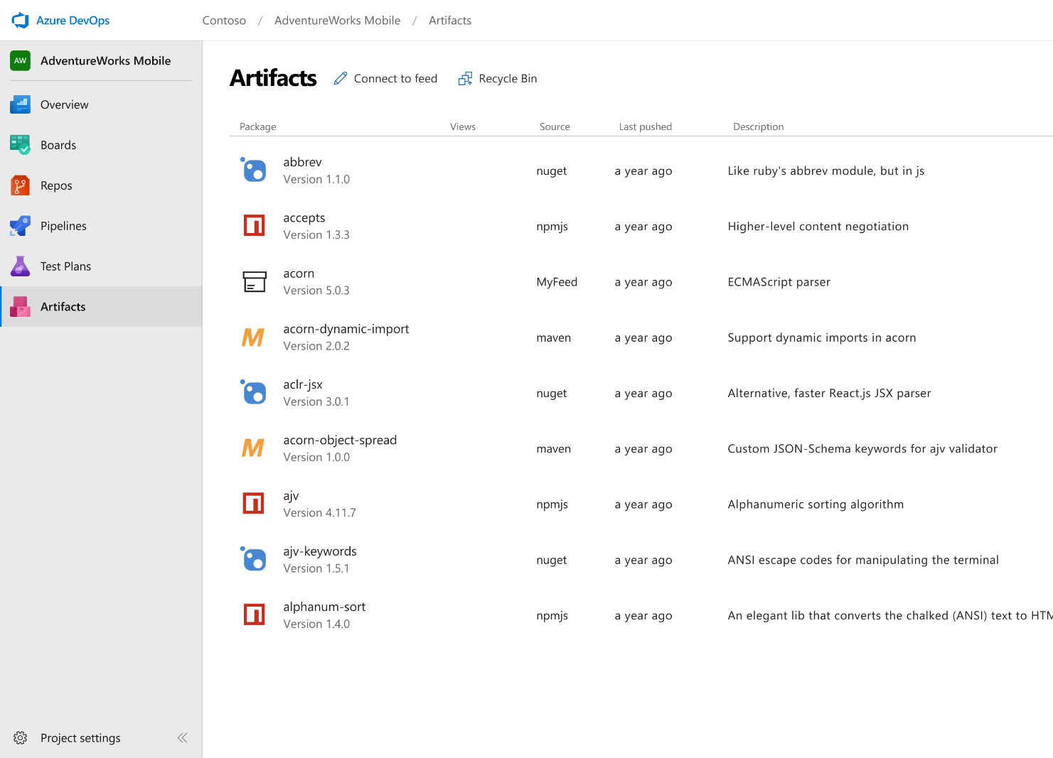



Azure Artifacts
Create and share Maven, npm, and NuGet package feeds from public and private sources – fully integrated into CI/CD pipelines
Manage all package types
Get universal artifact management for Maven, npm, and NuGet.
Add packages to any pipeline
Share packages, and use built-in CI/CD, versioning, and testing.
Share code efficiently
Easily share code across small teams and large enterprises.
➔
https://azure.com/devops

Slide 24

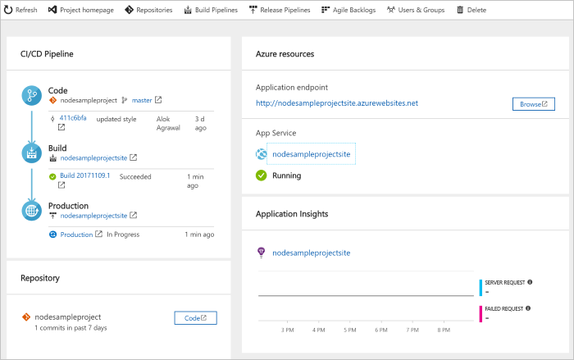
DevOps Pipelines in Minutes
Azure DevOps Projects
Create a full DevOps pipeline with 3 easy steps from the Azure Portal
Start with a Git repo and any source language
Web apps, Kubernates, soon VMs and more.
Customize, extend and scale when needed.
https://docs.microsoft.com/en-us/azure/devops-project/
➔
Notes:
Moving from the developer environment, Azure also makes deploying, or integrating existing, DevOps pipelines as fast as possible
Azure DevOps Projects is the quickest way to get started with DevOps on Azure for people who know about DevOps but are just starting or want a quick way to create a basic pipeline to play with or build upon.
DevOps projects creates a basic, complete CI/CD pipeline in Azure which can later be extended and customized outside in Azure Pipelines
Although DevOps Projects builds a DevOps pipeline on Azure it allows for any easy “Getting started” experience with Azure Pipelines which can then be applied to hybrid and on-prem scenarios with Azure Pipelines which can target any platform or with Azure DevOps Server which can be installed on prem.

Slide 25





Azure DevOps
Plan smarter, collaborate better, and ship faster with a set of modern dev services
Any developer, any platform, any cloud. Full support for hybrid cloud, on-premises & containers.
Use all the Azure DevOps services or choose just what you need to complement your existing workflows
Best in class builds for open source. Free unlimited build minutes for public projects and up to 10 free concurrent pipelines across Windows, Linux and macOS
Get started for free for small teams, scales to support the largest enterprises
Azure Boards
Azure Repos
Azure Pipelines
➔
https://azure.com/devops
Azure Test Plans
Azure Artifacts

Slide 26
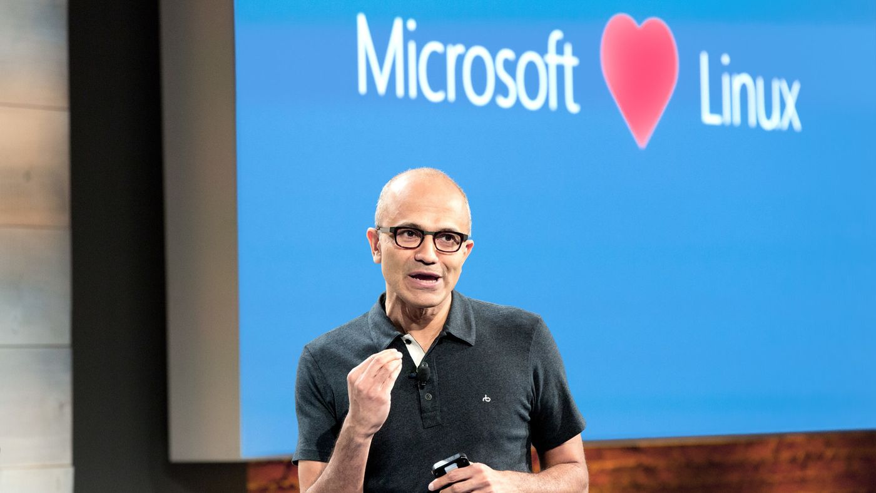
“Judge us by the actions we have taken in the recent past, our actions today and in the future”
—Satya Nadella, CEO Microsoft
2014
2018

Slide 27
Azure DevOps Services Pricing
Open Source Projects
Small Teams
Teams of any size
Free
Unlimited users and build time
Azure Pipelines: 10 parallel jobs with unlimited minutes for CI/CD
Azure Boards: Work item tracking and Kanban boards
Azure Repos: Unlimited public Git repos
Free
Start free with up to 5 users
Azure Pipelines: Run 1 Microsoft-hosted job for 1,800 minutes per month and 1 self-hosted job for any amount of time
Azure Boards: Work item tracking and Kanban boards
Azure Repos: Unlimited public Git repos
Azure Artifacts: package management
Unlimited stakeholders
Starts at $6 per user, per month for Boards & Repos*
Easy pricing that grows with your team
Azure Pipelines: Run 1 Microsoft-hosted job for 1,800 minutes per month and 1 self-hosted job for any amount of time
Azure Boards: Work item tracking and Kanban boards
Azure Repos: Unlimited public Git repos
Azure Artifacts: package management
Unlimited stakeholders
Boards & Repos included for Visual Studio subscribers
*
https://azure.microsoft.com/en-us/pricing/details/devops/azure-devops-services/
5 Boards & Repos users and 5 Artifacts users free. Pipelines with unlimited minutes, Test Plans users and additional Artifacts users also available. Please see the Azure pricing calculator for details.
➔

Slide 28
Compare Features Between Plans
Compare Azure DevOps features that are available to your users
See what you can do for *FREE* as a Stakeholder
Determine if you need to purchase an Azure DevOps User license
See what you can do for *FREE* for Open Source projects (aka Public Projects)
https://Azure.Microsoft.com/en-us/Services/DevOps/Compare-Features
➔

Slide 29
Azure DevOps Services Benefits for Visual Studio Subscribers
Visual Studio Professional
Visual Studio Test Professional & MSDN Platforms
Visual Studio Enterprise
Basic Features
Basic Features
Test Manager
Basic Features
Test Manager
Artifacts (Package Management)
1 Concurrent Job of Self-Hosted CI/CD
https://docs.microsoft.com/en-us/visualstudio/subscriptions/vs-azure-devops
➔

Slide 30
Resources
Be passionate and bold. Always keep learning. You stop doing useful things if you don't learn.
- Satya Nadella

Slide 31
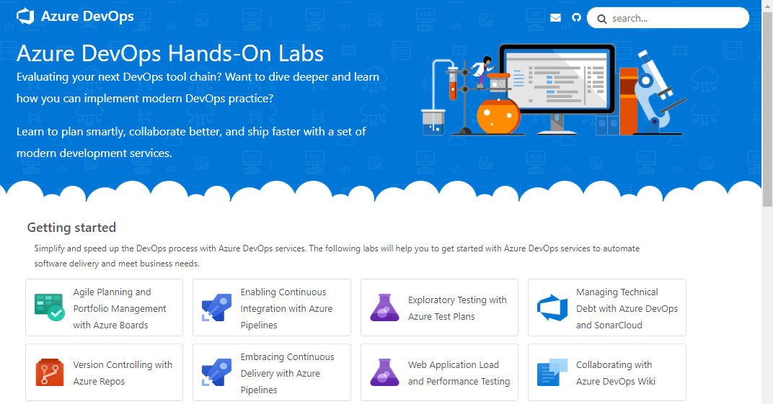
Azure DevOps Hands-On Labs
Learn to plan smartly, collaborate better, and ship faster with a set of modern development services.
Get Hands On Experience with Azure DevOps Services – Learn how you can plan better, code together and ship faster with Azure DevOps Services.
Getting started - These labs will help you to get started with Azure DevOps services to automate software delivery and meet business needs.
Deep Dive into Azure DevOps - Learn how to integrate with popular OSS and 3rd party tools and services. Use the tools and languages you know.
https://www.AzureDevOpsLabs.com
➔

Slide 32
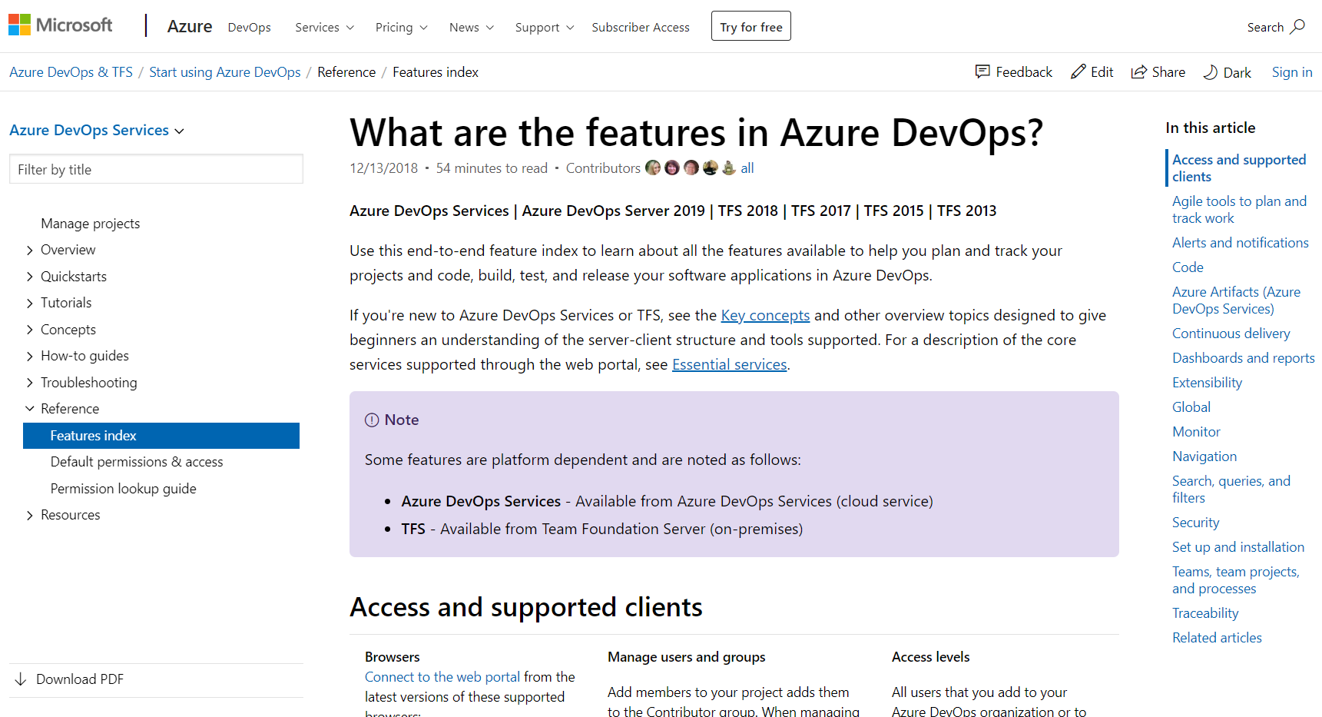
Documentation - Azure DevOps Feature Index
Use this end-to-end feature index to learn about all the features available in Azure DevOps
If you're new to Azure DevOps Services or TFS, see the Key concepts
For a description of the core services supported through the web portal, see Essential services
If you only save one Favorite in your browser related to Azure DevOps, this is the link to save as a favorite!
https://Docs.Microsoft.com/en-us/Azure/DevOps/User-Guide/ALM-DevOps-Features
➔

Slide 33
DevOps Pipelines in Minutes
Azure DevOps Projects
Create a full DevOps pipeline with 3 easy steps from the Azure Portal
Start with a Git repo and any source language
Web apps, Kubernates, soon VMs and more.
Customize, extend and scale when needed.
https://docs.microsoft.com/en-us/azure/devops-project/
➔
Notes:
Moving from the developer environment, Azure also makes deploying, or integrating existing, DevOps pipelines as fast as possible
Azure DevOps Projects is the quickest way to get started with DevOps on Azure for people who know about DevOps but are just starting or want a quick way to create a basic pipeline to play with or build upon.
DevOps projects creates a basic, complete CI/CD pipeline in Azure which can later be extended and customized outside in Azure Pipelines
Although DevOps Projects builds a DevOps pipeline on Azure it allows for any easy “Getting started” experience with Azure Pipelines which can then be applied to hybrid and on-prem scenarios with Azure Pipelines which can target any platform or with Azure DevOps Server which can be installed on prem.

Slide 34
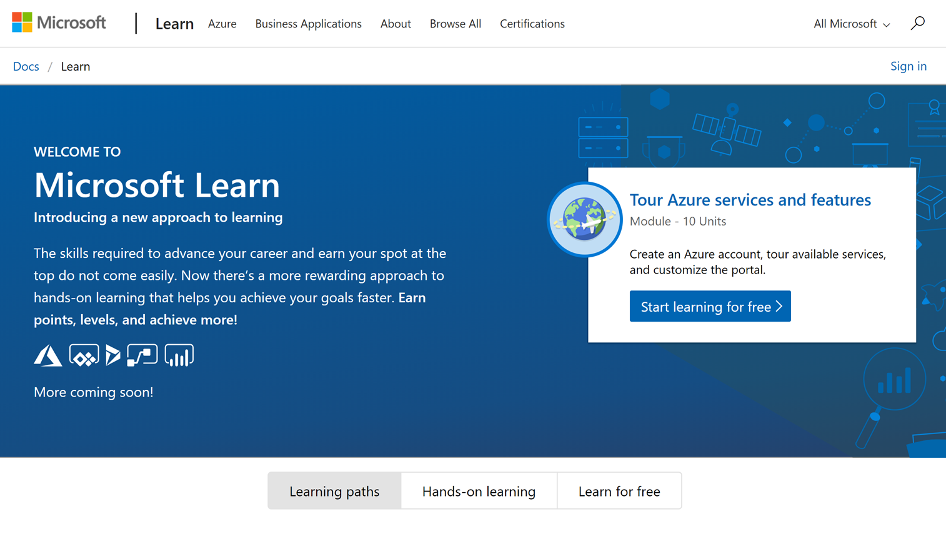
Microsoft Learn
Build your skills fast with free, interactive tutorials at Microsoft Learn, a new training experience for technical users.
Step-by-step training to fit your schedule
Interactive coding environments for hands-on experience
Earn achievements and recognition for your Azure skills
We provide free Azure sandboxes, free virtual machines, etc. so there is nothing to setup ahead of time
http://www.Microsoft.com/Learn
➔
Notes:
Introducing Microsoft Learn – the Best place to start learning Microsoft technologies – Free!
Quickly build skills: interactive, step-by-step bite-size tutorials
Learn by doing: browser-based interactive coding environments for hands-on experience. Free fixed-time access to create and manage Azure resources - no credit card required.
Earn recognition: Track progress, check knowledge, and validate deployments to earn points, levels, achievements, and trophies
Learning aligned to new role-based certifications: easier for you to prepare for certification and be recognized as a leader in Microsoft technologies
Multiple modes of learning: learn in way best for you. select from free self-paced quick tutorials and hands-on learning, to structured online courses free from Pluralsight and instructor led classes from learning partners. Get started by selecting a Learning Path that is closest to your role, e.g. Business Analyst , Azure Developer , Azure Solution Architect . Regarding the individual modules: You can start with the basics such as Tour Azure services and features or go deep with something like Create serverless applications.

Slide 35
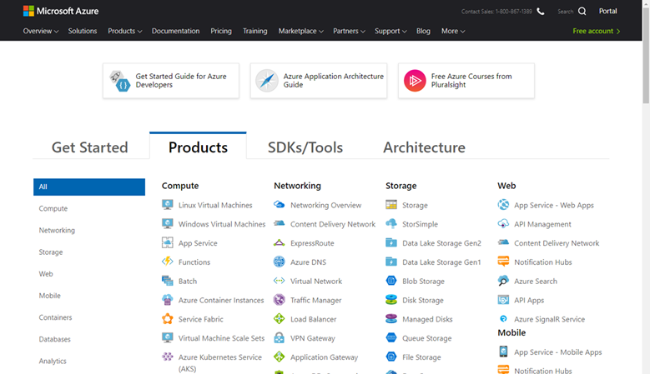
Documentation - Azure Services Index
Use this end-to-end index to learn about all the services available in Azure
Use this end-to-end feature index to learn about all Azure services.
If you only save one Favorite in your browser related to Azure, this is the link to save as a favorite!
Most topics contain Quickstarts and Tutorials allowing you to gain hands-on experience quickly
https://docs.microsoft.com/en-us/Azure/#pivot=products&panel=all
➔

Slide 36
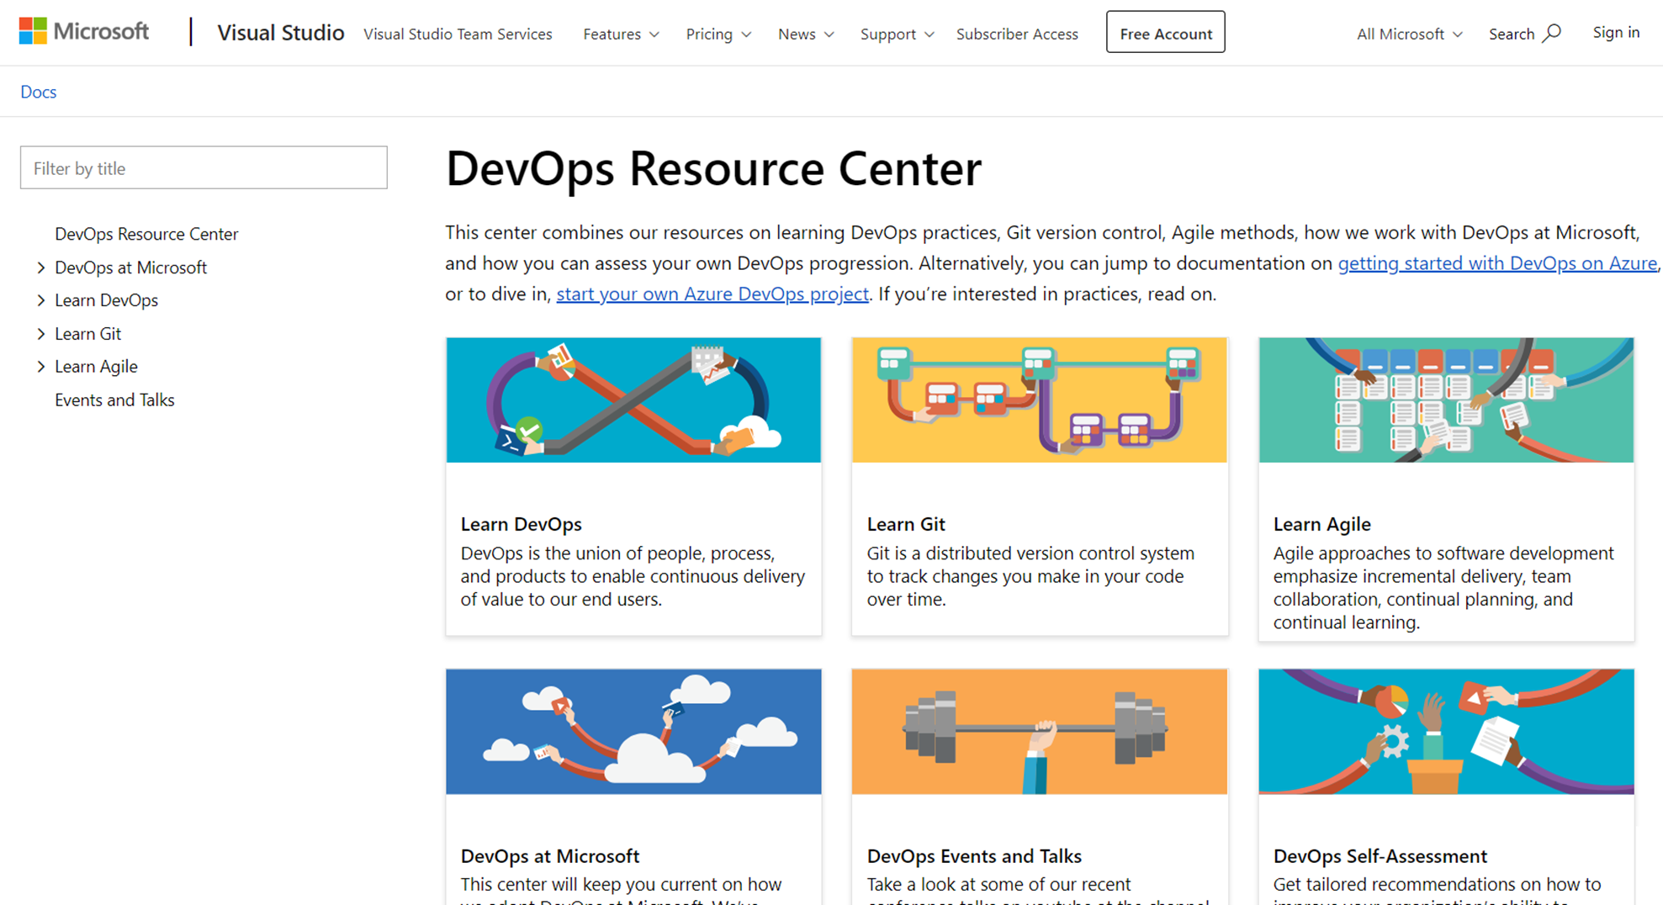
Learn DevOps in the DevOps Resource Center
This center combines our resources on learning DevOps practices, Git version control, Agile methods, how we work with DevOps at Microsoft, and how you can assess your own DevOps progression
Learn DevOps - DevOps is the union of people, process, and products to enable continuous delivery of value to our end users
DevOps at Microsoft - This center will keep you current on how we adopt DevOps at Microsoft
DevOps Self-Assessment - Get tailored recommendations on how to improve your organization's ability to develop and deliver value to customers, pivot when necessary, and beat competitors to market
http://aka.ms/DevOps
➔

Slide 37
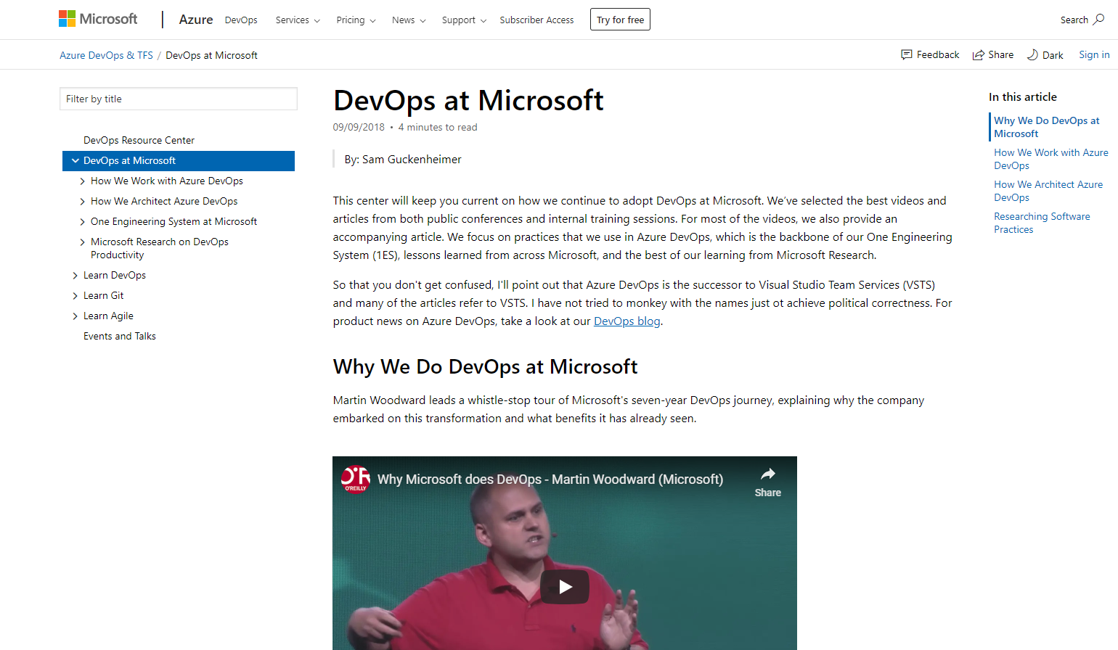
DevOps at Microsoft
Learn from our DevOps journey and share our lessons learned with your team
Create a series of “Lunch & Learn” sessions. Watch a video and have a follow up discussion with your team
Or, treat it like a book club, i.e. have everyone watch a video and read the related narrative, then discuss it over lunch
Either way, discuss with your team what is/is not applicable to your company, (or, what should be applicable in the future!)
http://aka.ms/DevOpsAtMicrosoft
➔

Slide 38
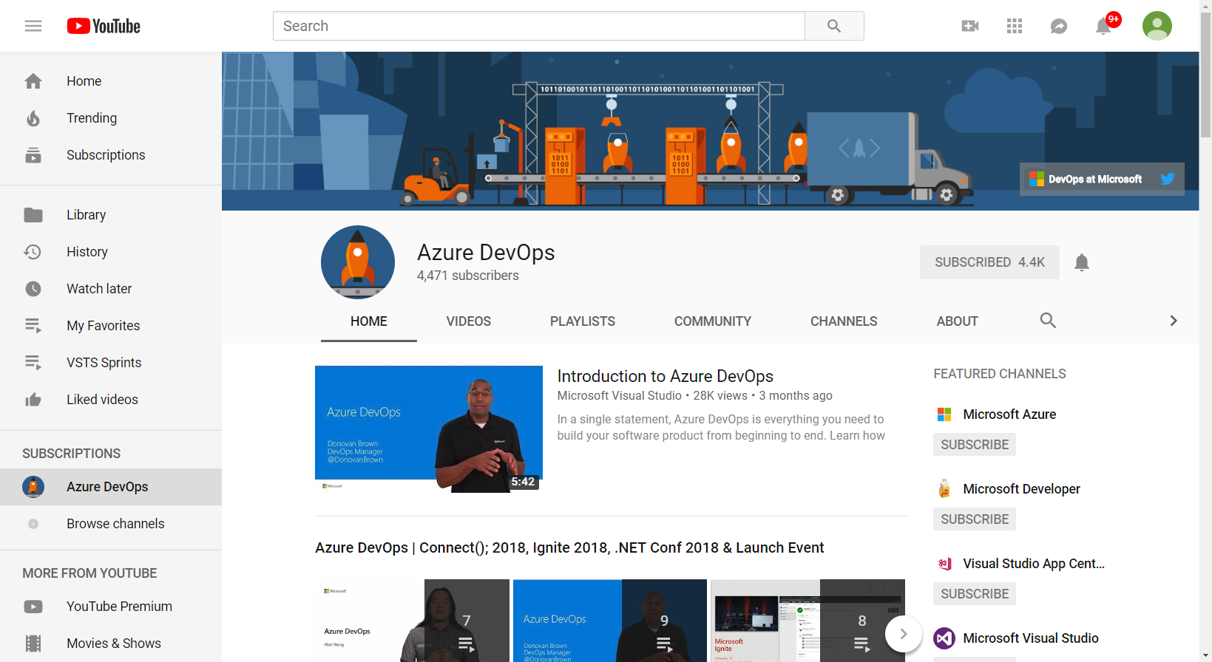
”DevOps at Microsoft” YouTube channel
Learn more about Azure DevOps through videos
Events - Keynotes and break out sessions from events such as Connect(); Ignite, .NET Conf and //Build
DevOps Interviews (Channel 9 Shows) - DevOps Interviews from around Microsoft and the community hosted by Microsoft's Donovan Brown
DevOps Labs (Channel 9 Shows) - Damian Brady goes deep into various DevOps Pipelines topics
DevOps On Azure - OSS Projects, Jenkins, Terraform & more
https://www.youtube.com/channel/UC-ikyViYMM69joIAv7dlMsA
➔

Slide 39
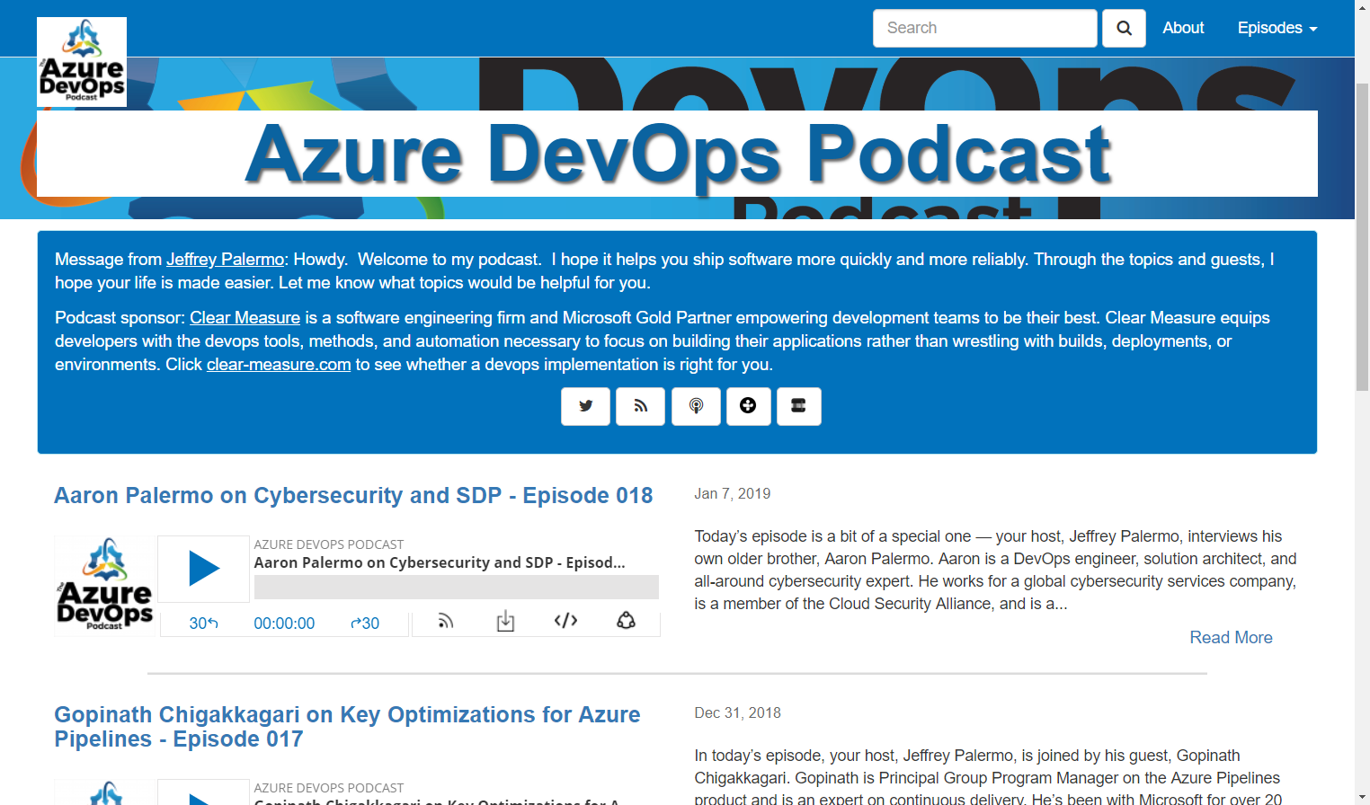
Azure DevOps Podcast
The Azure DevOps Podcast is a show for developers and devops professionals shipping software using Microsoft technologies.
Each show brings you interviews with industry experts sharing better methods & success stories.
Listen in to learn how to increase quality, ship quickly, and operate well.
Hosted by Jeffrey Palermo and sponsored by Clear Measure, Inc.
http://AzureDevOpsPodcast.Clear-Measure.com
➔

Slide 40
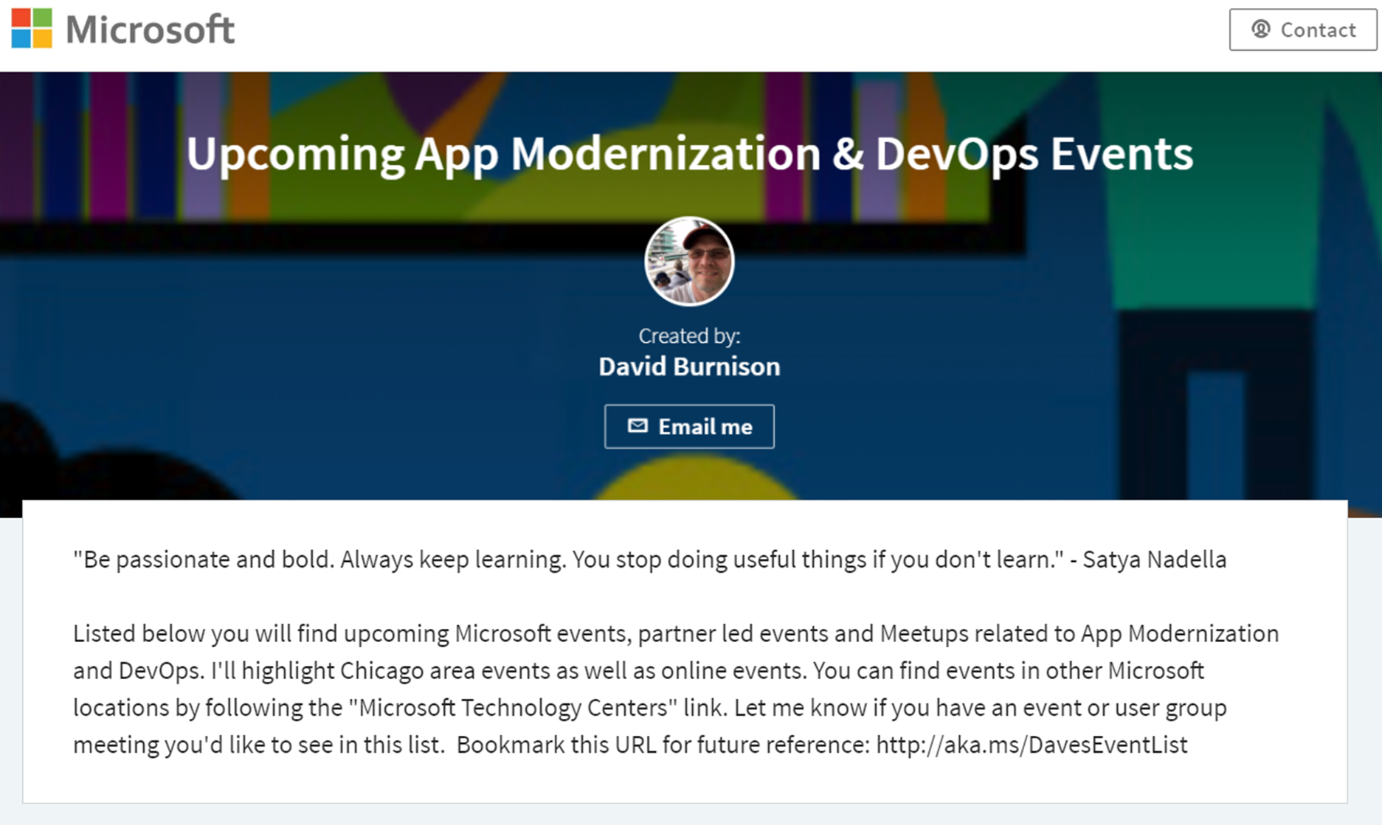
Upcoming App Modernization & DevOps Events
Microsoft events, partner led events and Meetups related to App Modernization and DevOps
I highlight Chicago area events as well as online live and on-demand events
You can find events in other Microsoft locations by following the "Microsoft Technology Centers" link
Let me know if you have an event or user group meeting you'd like to see in this list
Bookmark this URL for future reference: http://aka.ms/DavesEventList
http://aka.ms/DavesEventList
➔

Slide 41

Questions?
Contact Dave Burnison Dave.Burnison@Microsoft.com
@DaveBurnison
http://aka.ms/DavesEventList

Slide 42

Thank You!
Please fill out survey
Content: aka.ms/omahadevdays
Survey: aka.ms/ncrdevdayssurvey

Slide 43
